Slide 1
Yelp Modeling Tasks

Slide 2
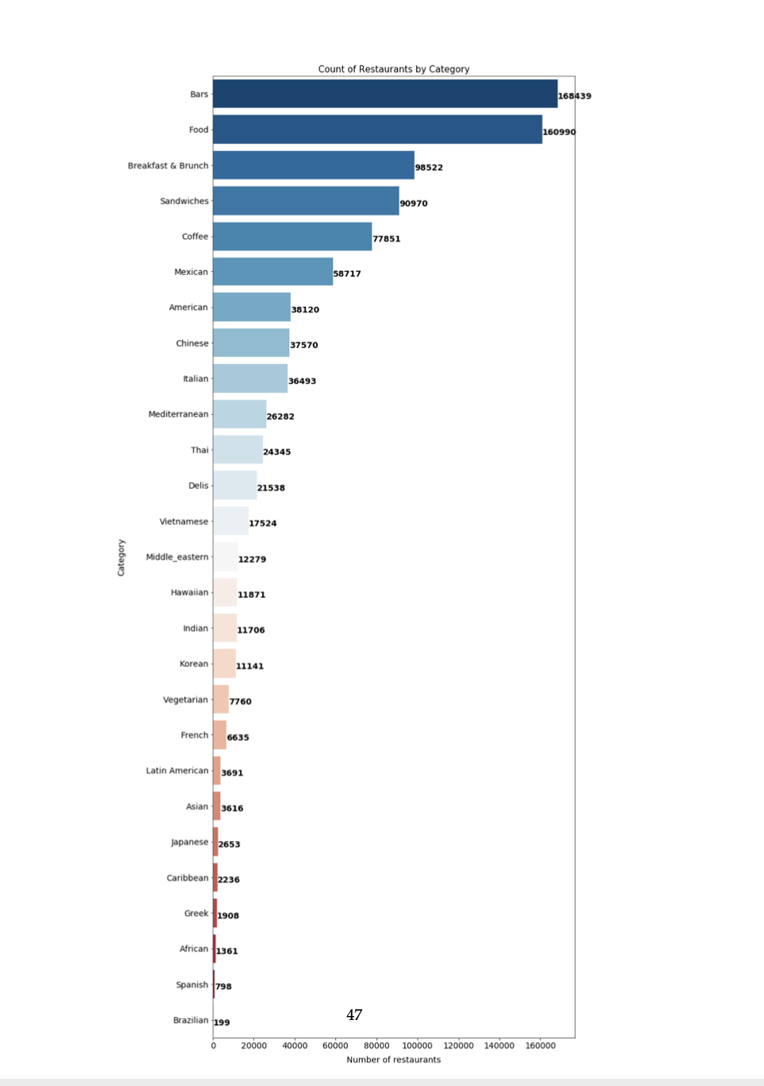
Count by Category

Slide 3
Topics Covered
Selected modeling technique
Generated Test Design
Run the developed models
How models will be assessed

Slide 4
Task #1 Generating Restaurant Recommendations for a User
Collaborative Filtering
Decision Tree
Multinomial Naive Bayes
Content Filtering
We are splitting 30% for test and 70 percent for training.
For evaluation we since this is a classification problem, we are using a confusion matrix.
We will determine if we use more evaluation metrics

Slide 5
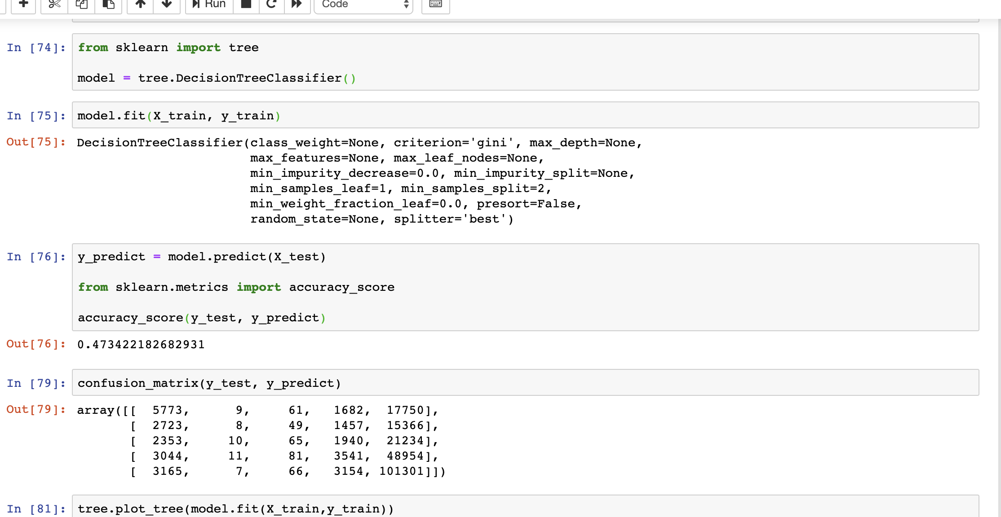
Based on Review count and business_stars, can we predict if a customer would like the place?

Slide 6
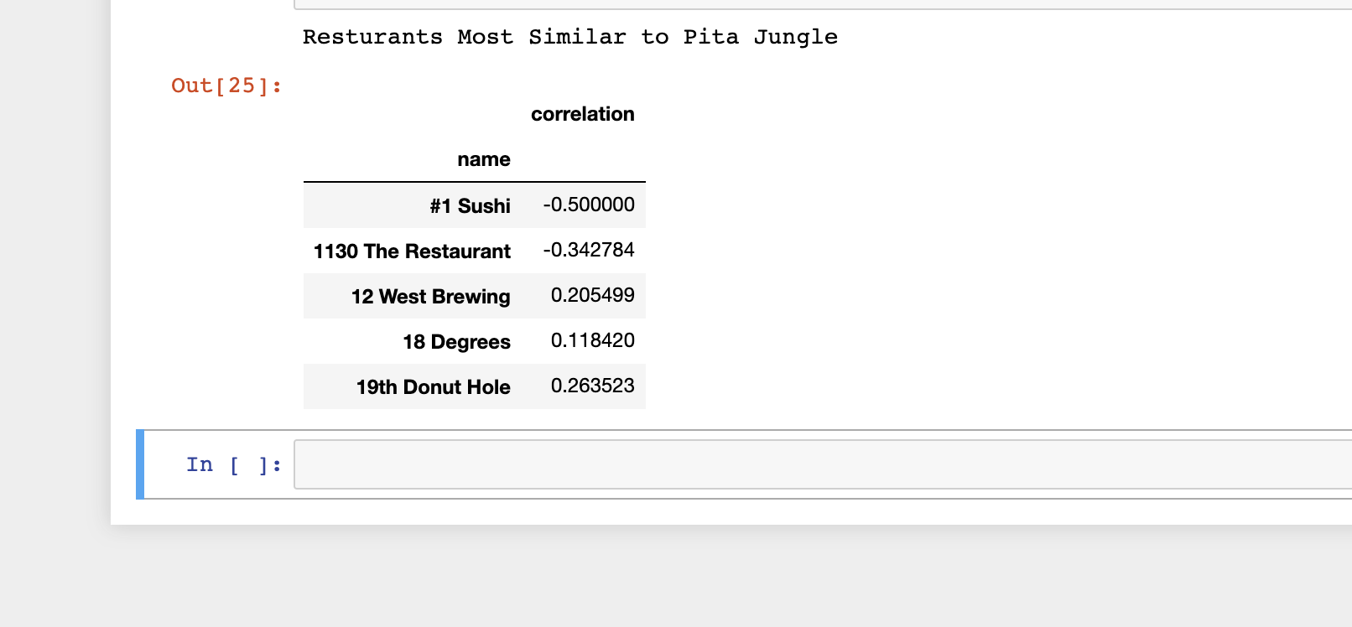

We tried the model with seeing what restaurants are most similar to Pita Jungle. The correlations we got were small.
But this approach can be improved with a Memory Based-Collaborative Filtering. Or a model based collaborative filtering which is good with dealing with scalability and sparsity. If we do this we can evaluate with RSME.

Slide 7
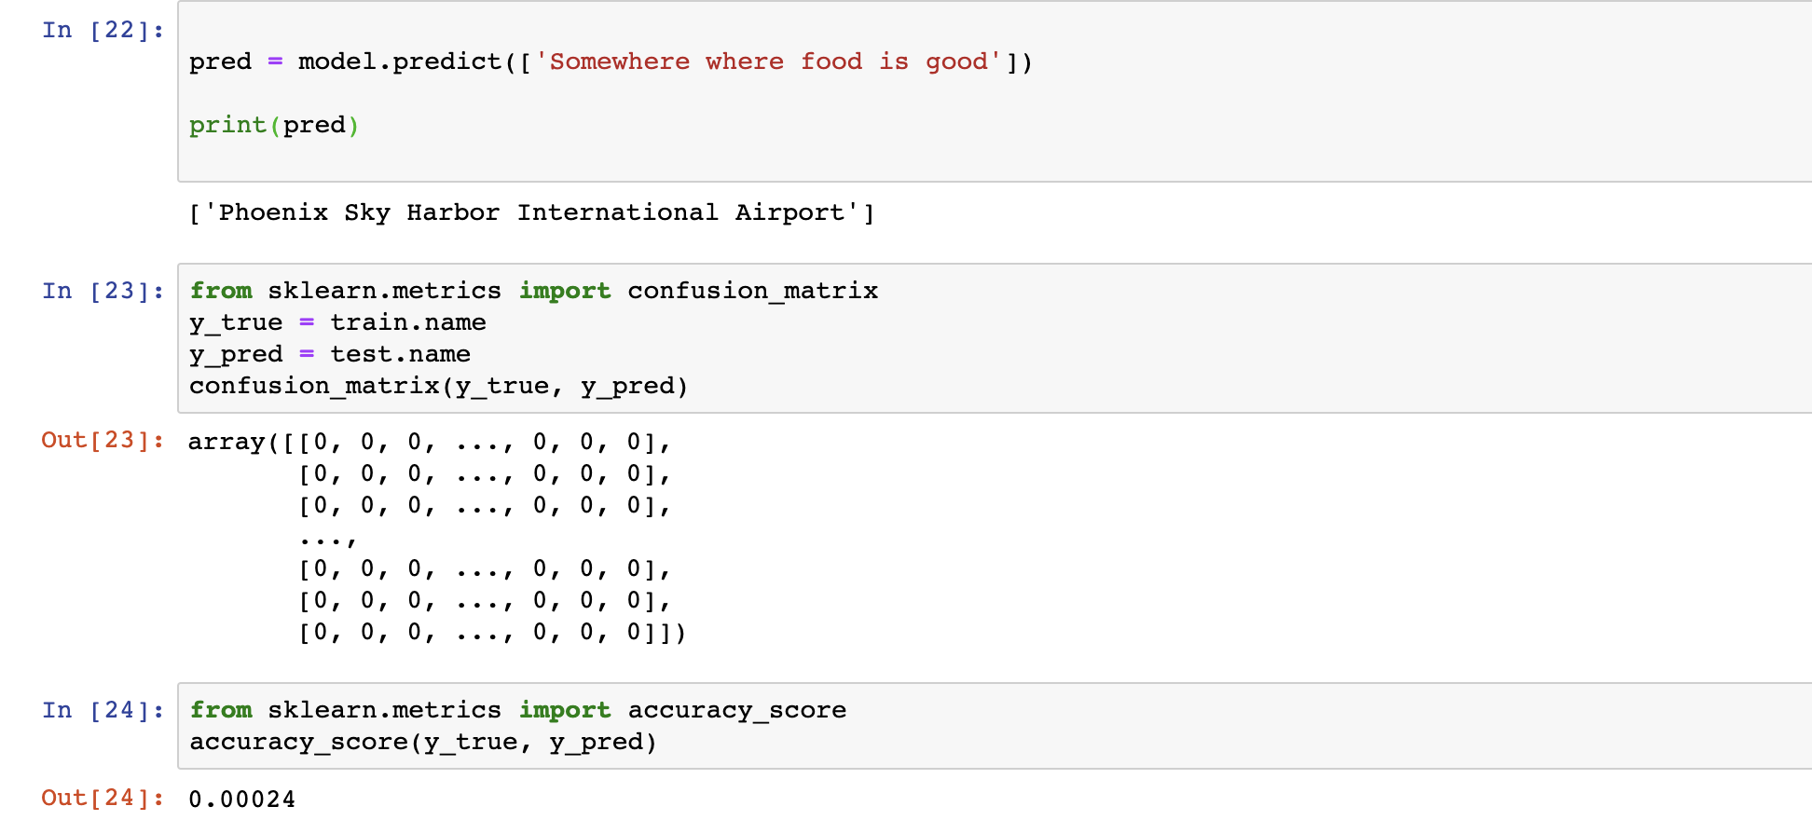


Slide 8
Using a Multinominal naive bayes, based on the cleaned tips, we are trying to classify what words can gear you towards the right recommendation.
Unfortunately with this approach.
The accuracy was almost close to 0.
Right now this approach would need a quite a bit of work. I honestly, feel that maybe we would get more out out of it using reviews. It could be how we preprocessed the data.

Slide 9
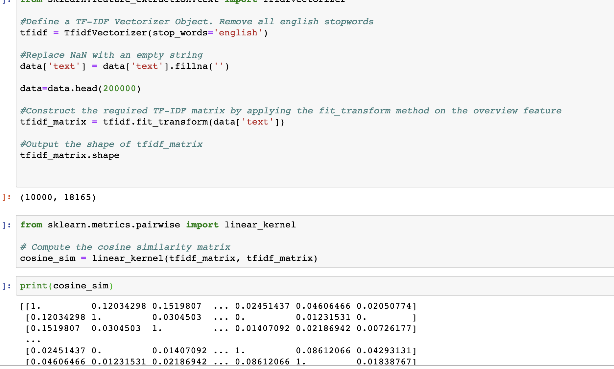

Slide 10
Approach being utilized for Content Based Filtering
Accuracy of similar content is small.
Question if we are choosing the right features?
Testing with a cosine similarity (metric)
RSME
Precision (Derived from Confusion Matrix)
Recall (Derived from Confusion Matrix)

Slide 11
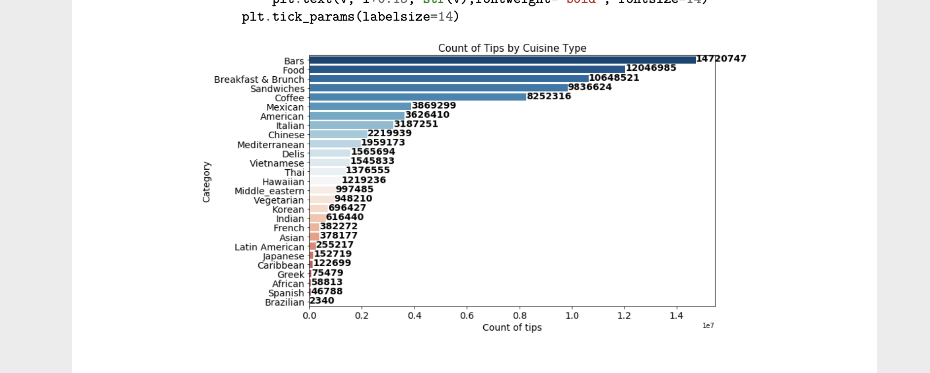

Slide 12
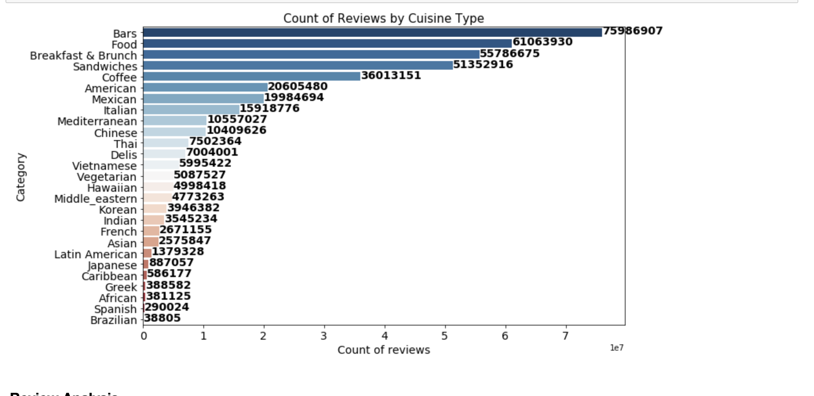

Slide 13
Task #2 Sentiment Analysis
Are we able to determine if tips are positive or negative depending on business stars?
Are we able to determine if reviews are positive or negative?
Can we get what concerns a customer or what makes a customer happy?
For this approach:
For feature extraction we are using the CountVectorizer
We are splitting 30% for test and 70 percent for training.
For evaluation we since this is a classification problem, we are using a confusion matrix.

Slide 14
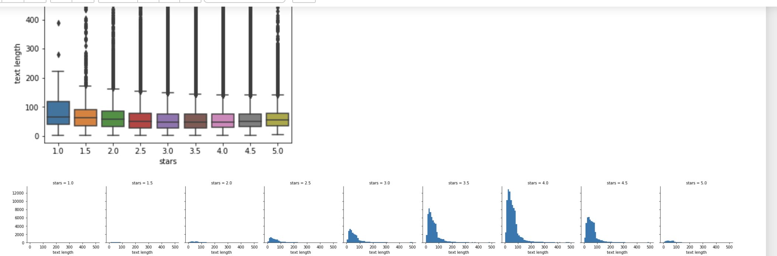
Tips Sentiment

Slide 15
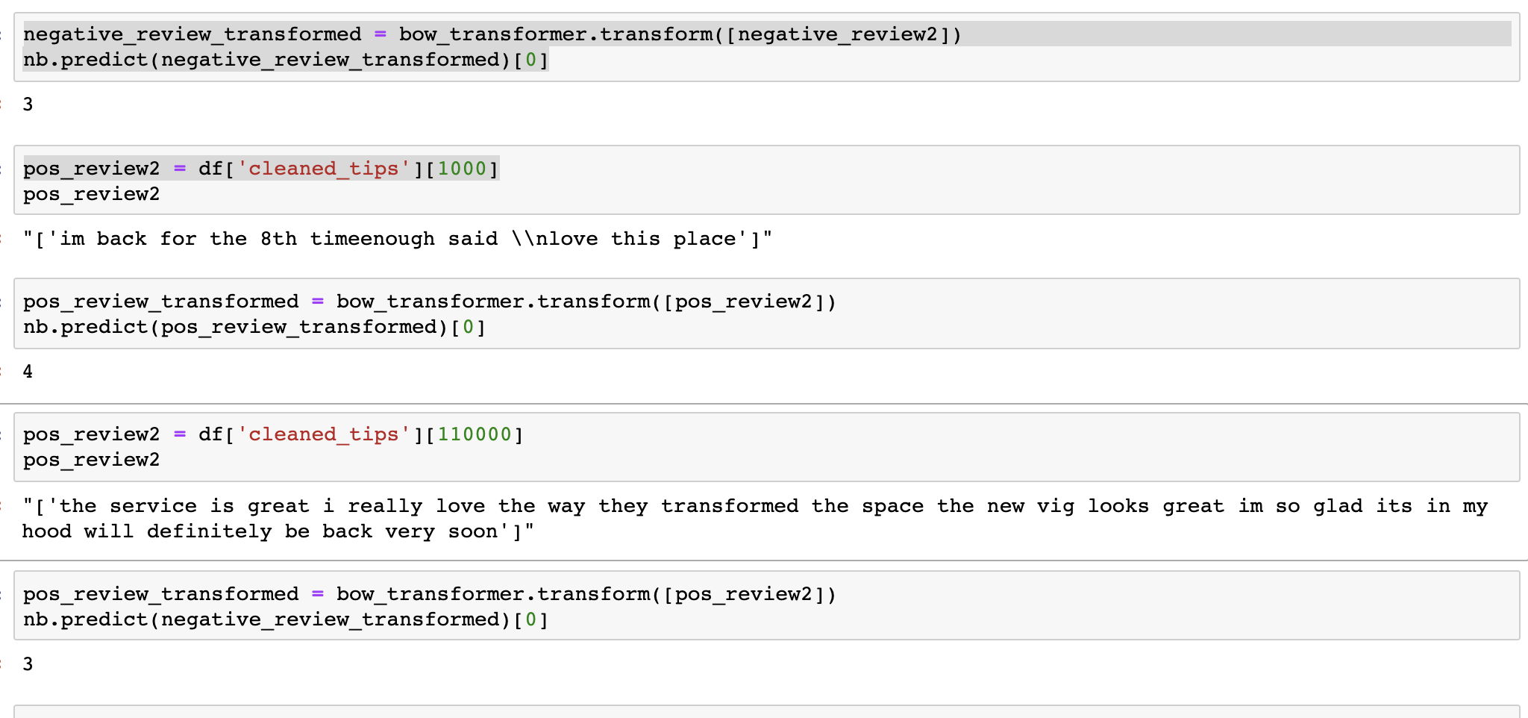

Slide 16
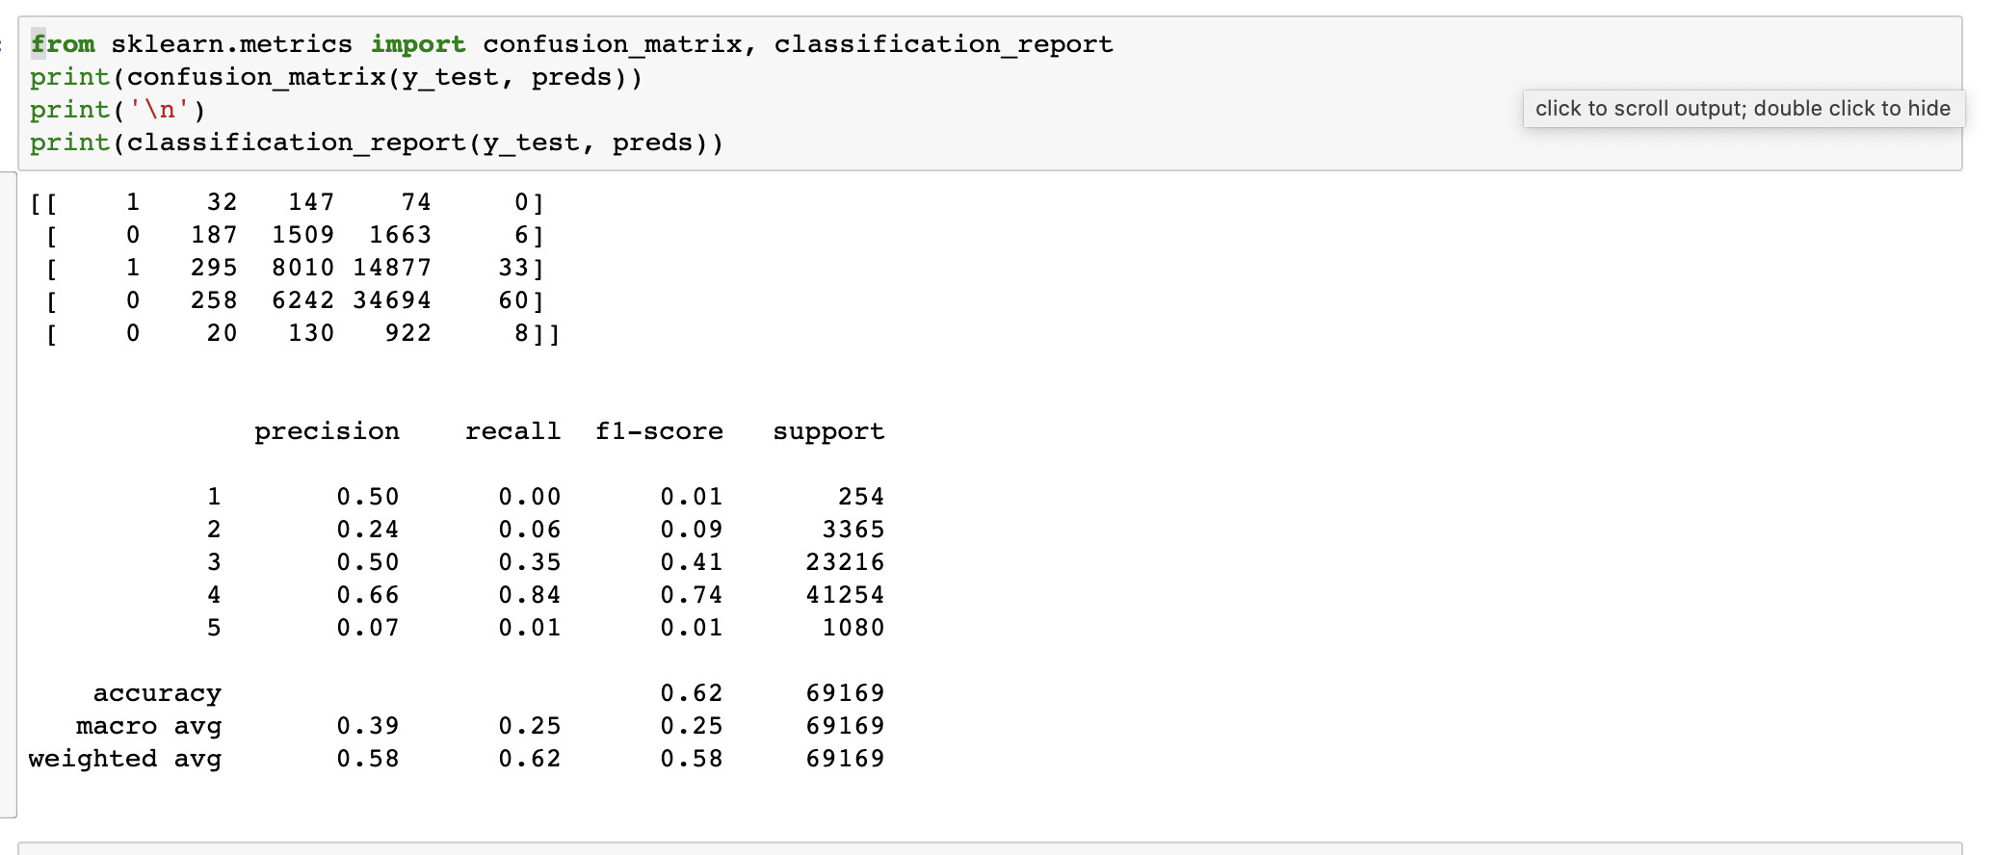

Slide 17
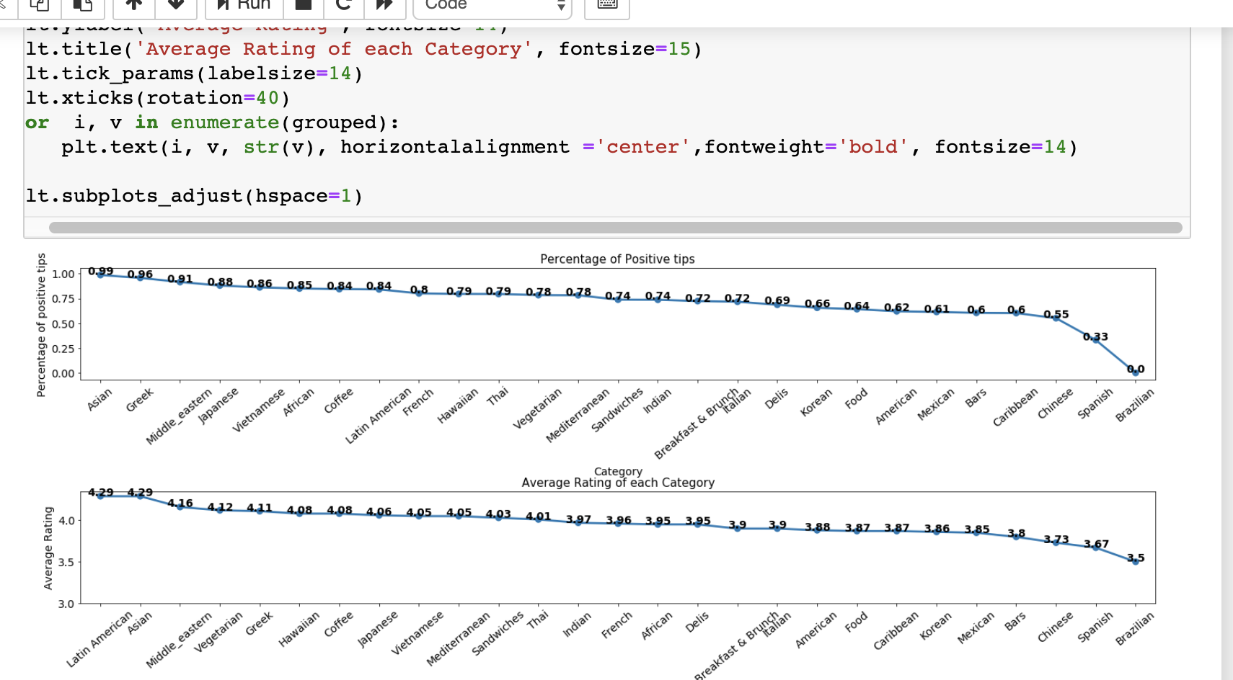

Slide 18
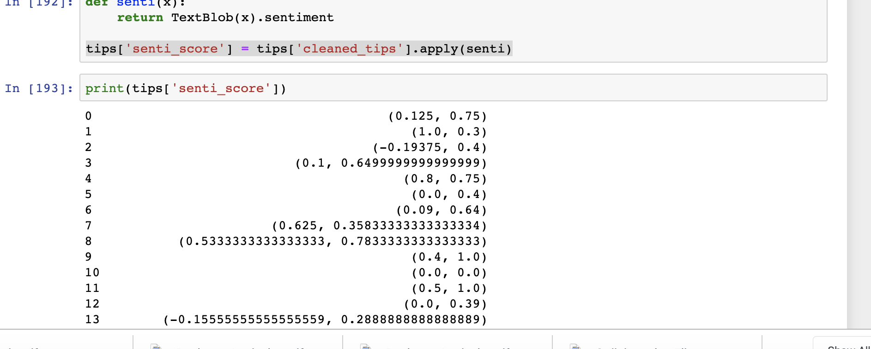

Slide 19
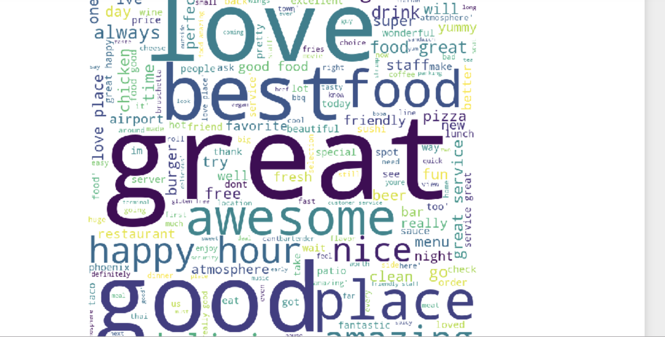
Positive Words

Slide 20
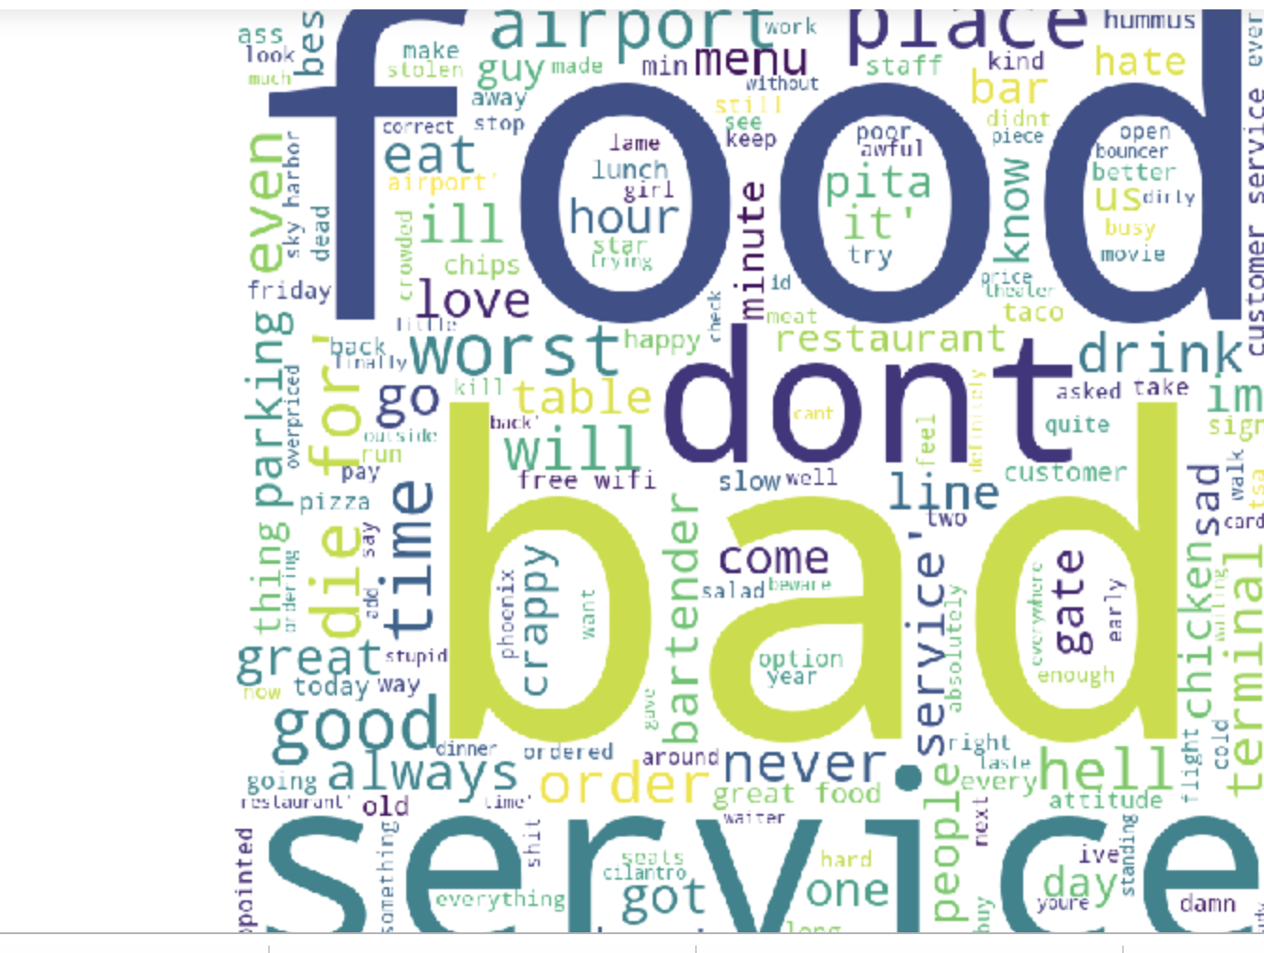
Negative Words

Slide 21
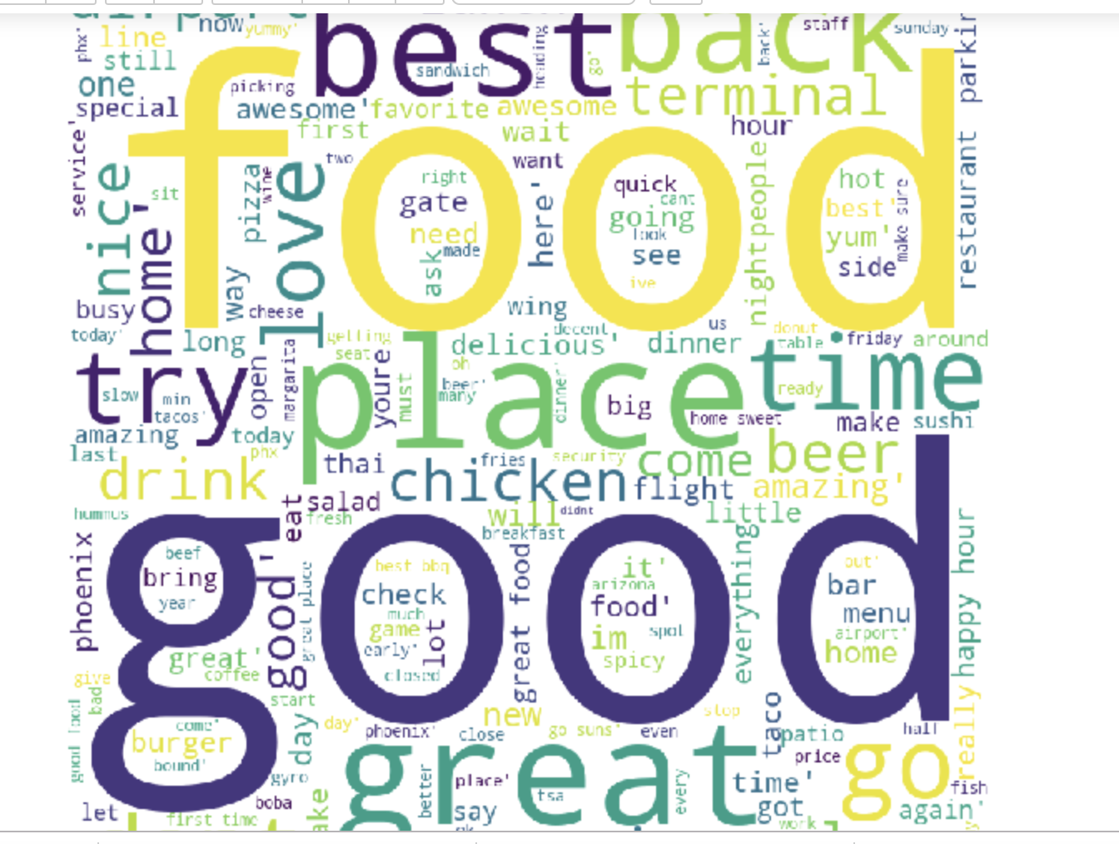
Neutral Words

Slide 22
Evaluation Techniques
Subjectivity Rating
Confusion Matrix

Slide 23
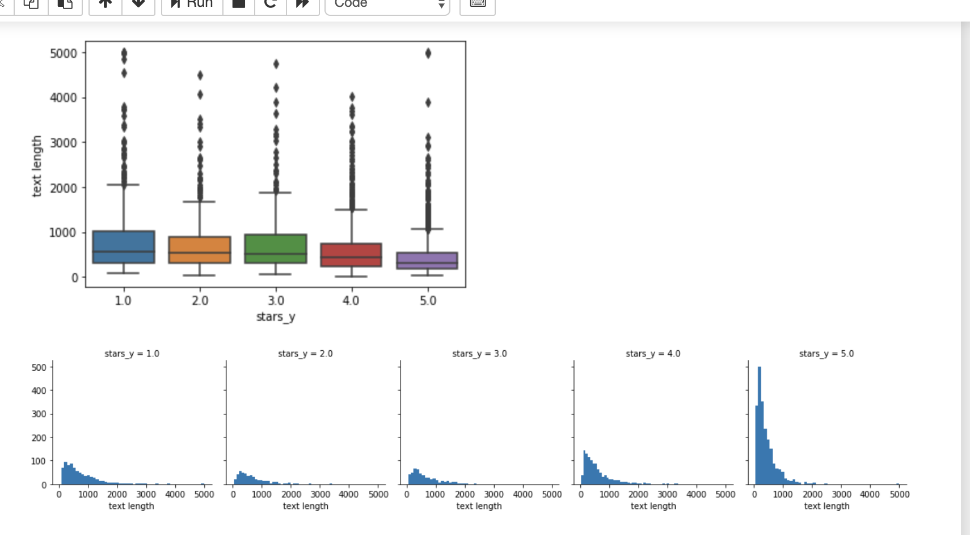
Reviews

Slide 24
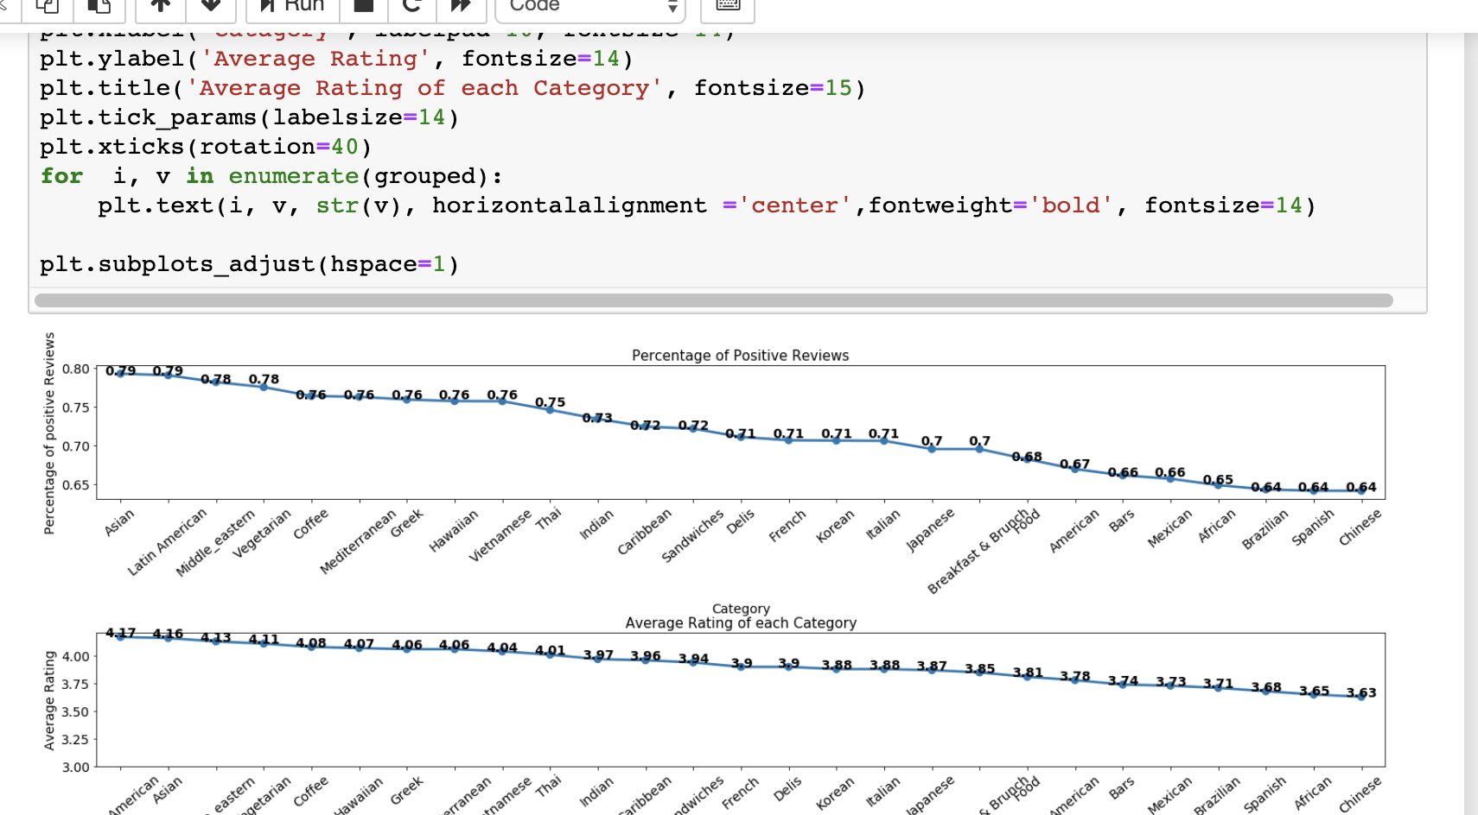

Slide 25
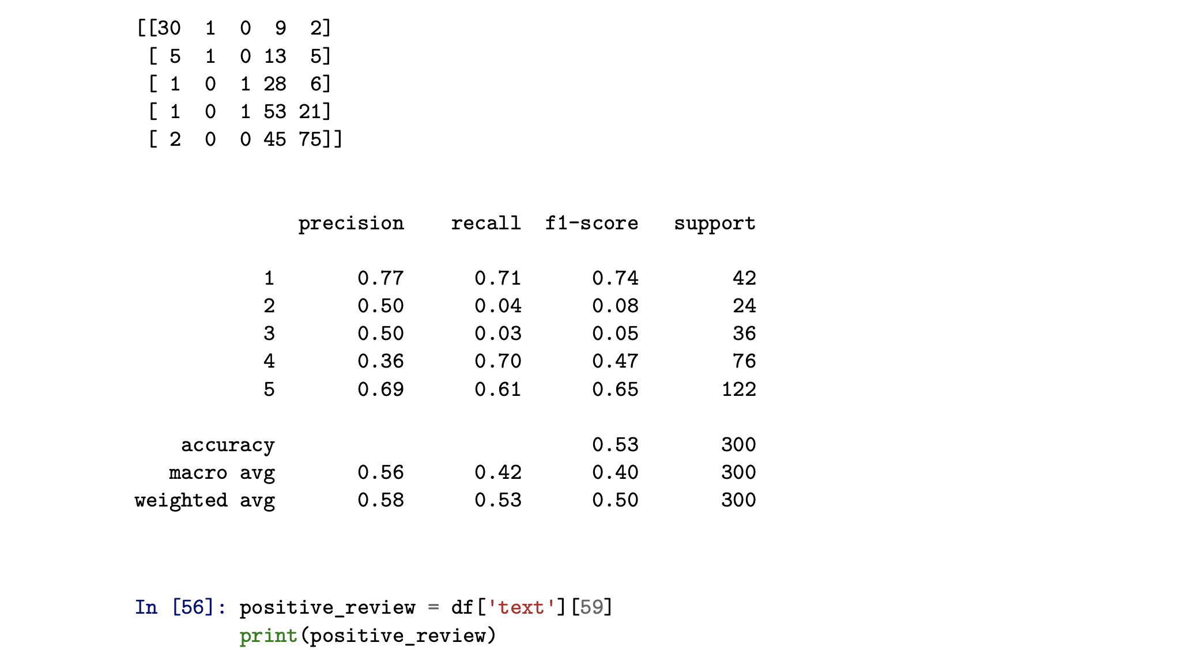

Slide 26
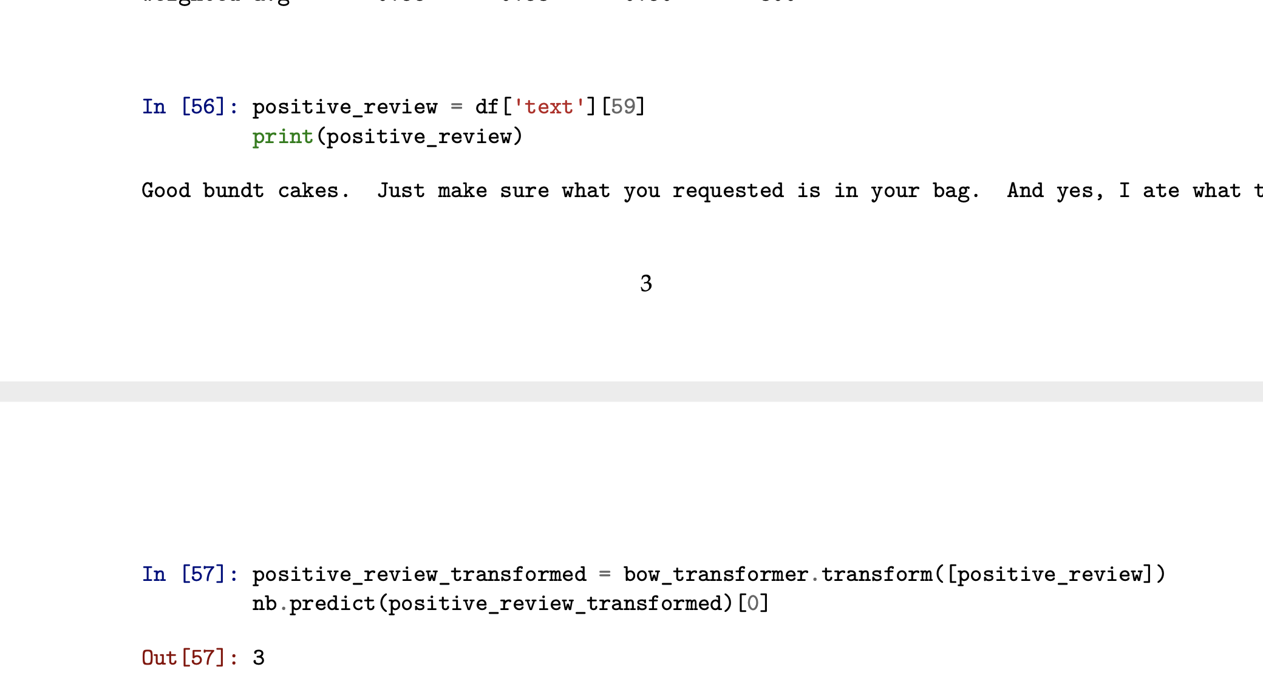
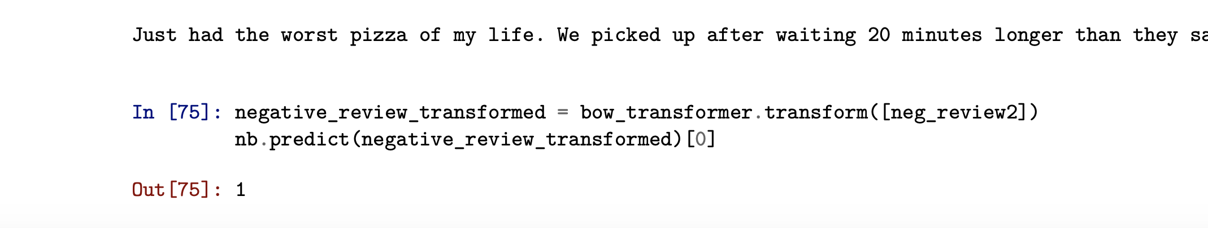

Slide 27
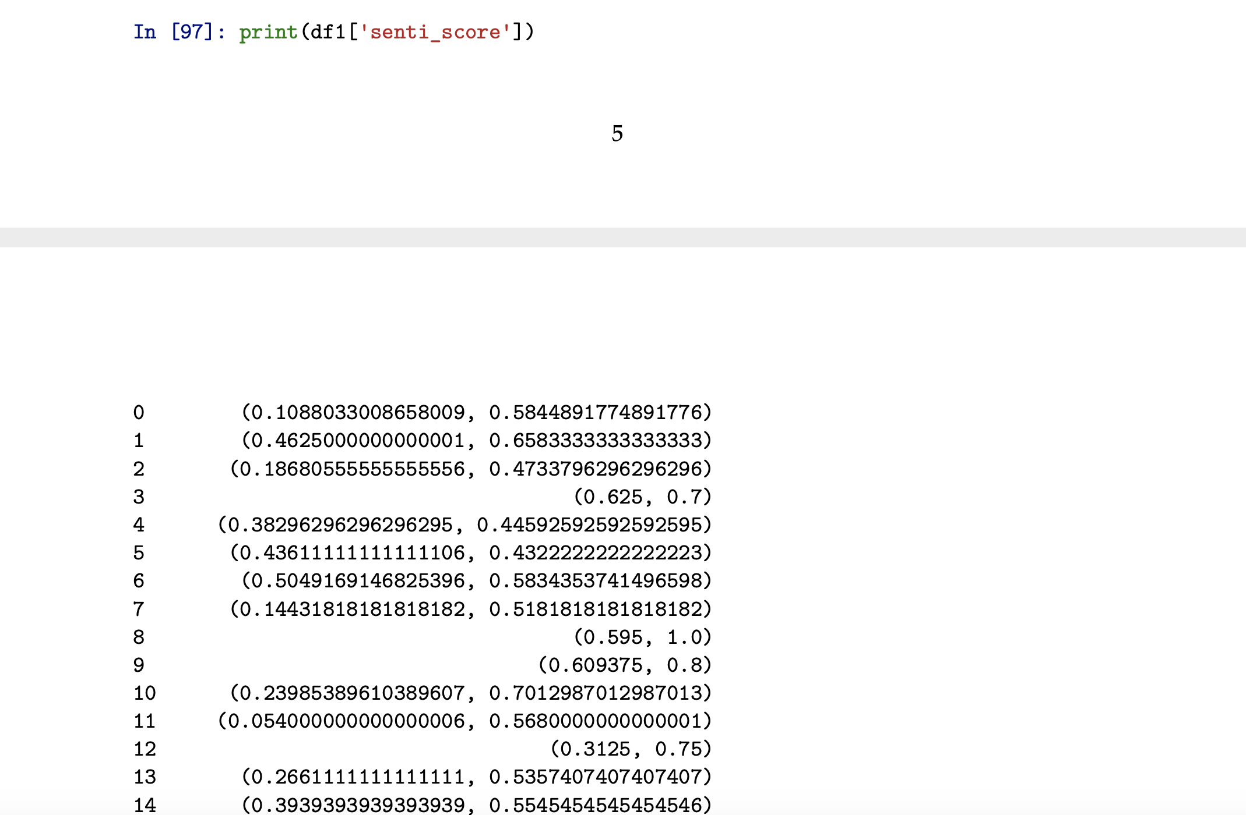

Slide 28
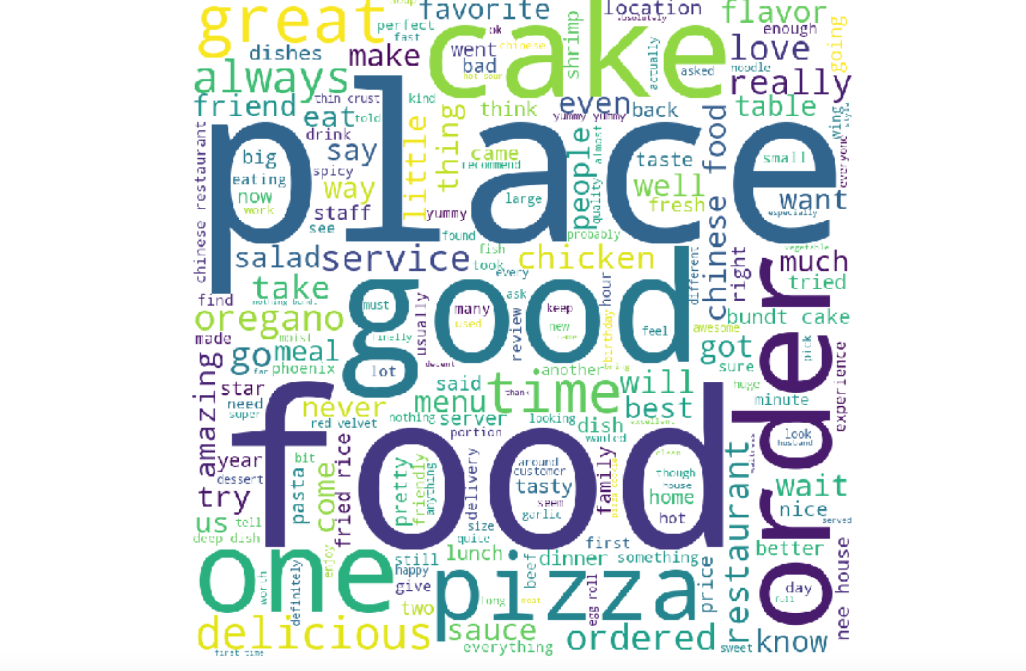
Positivity

Slide 29
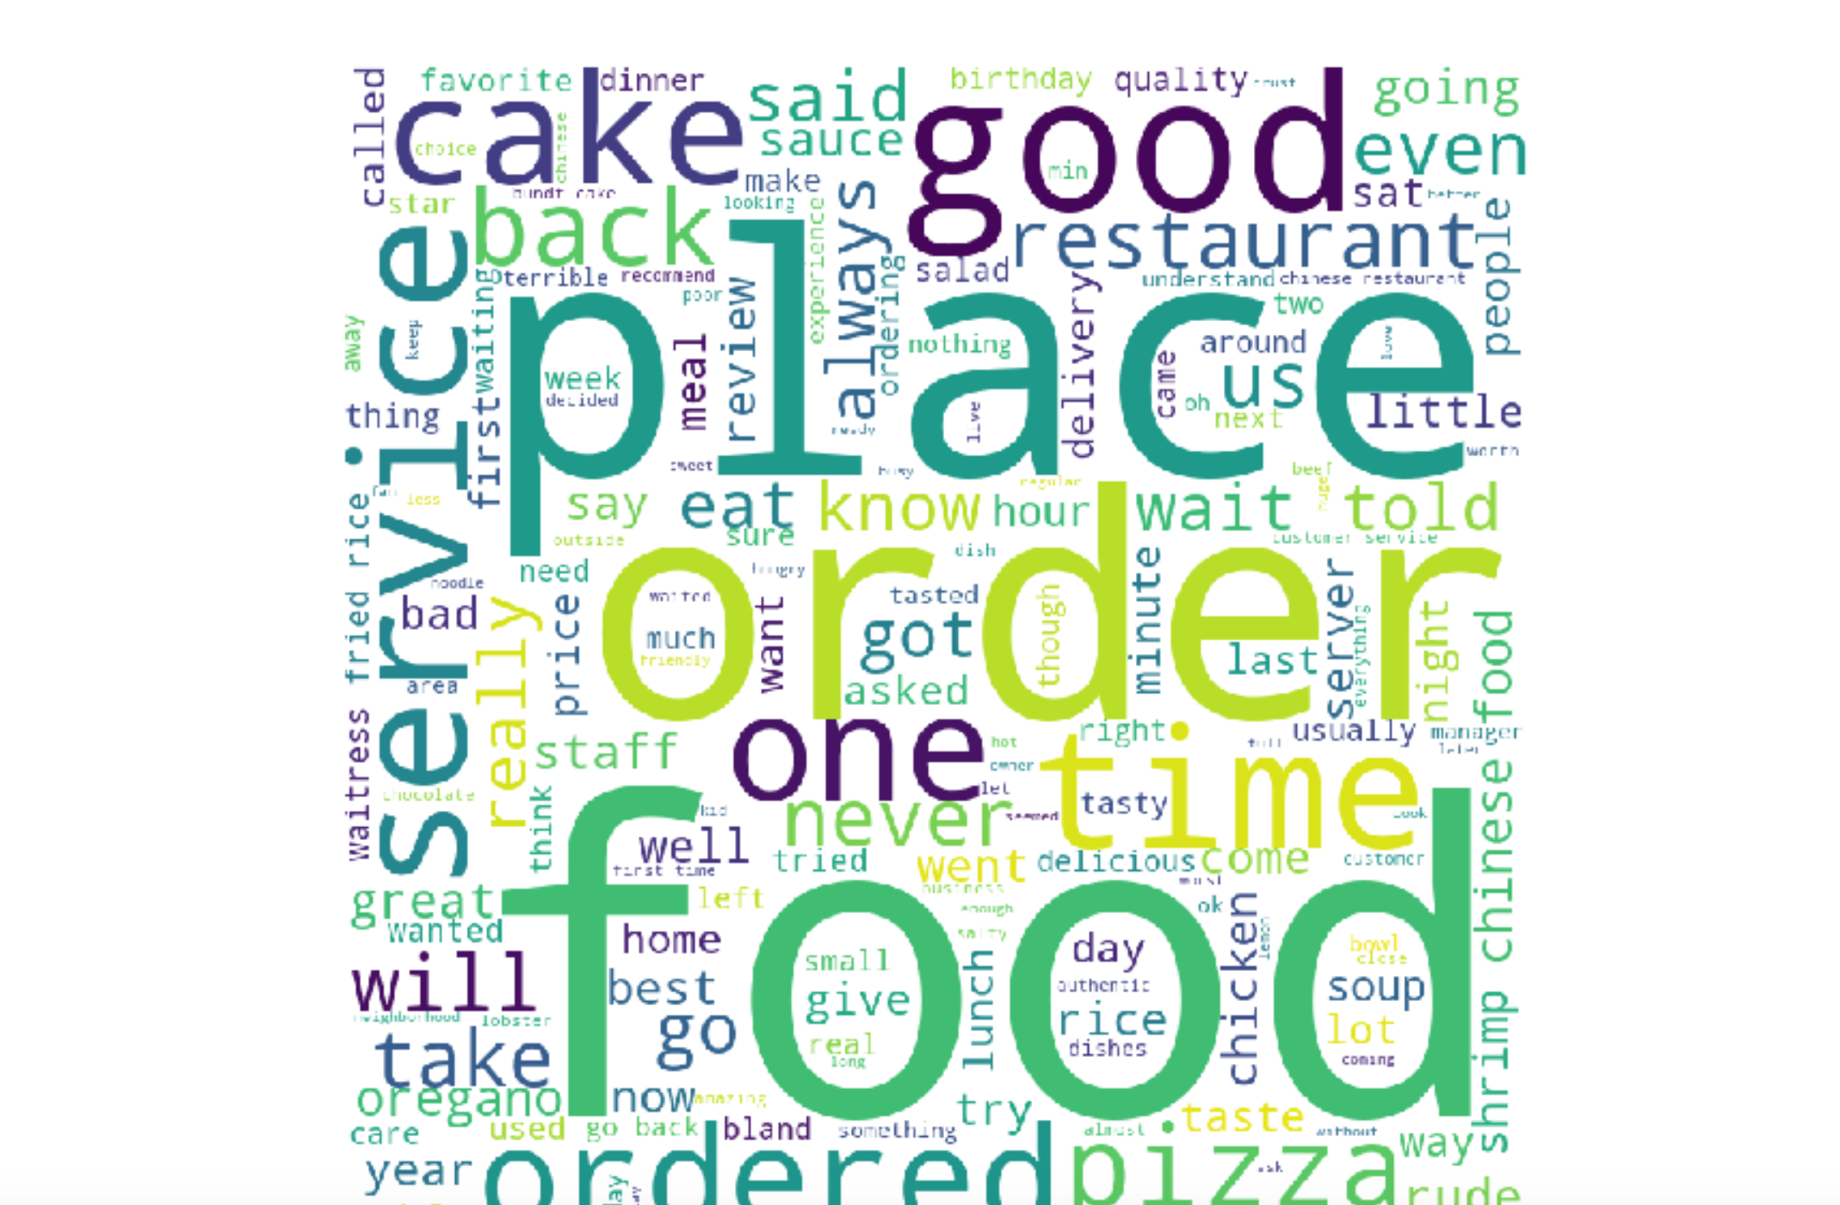
Netural

Slide 30
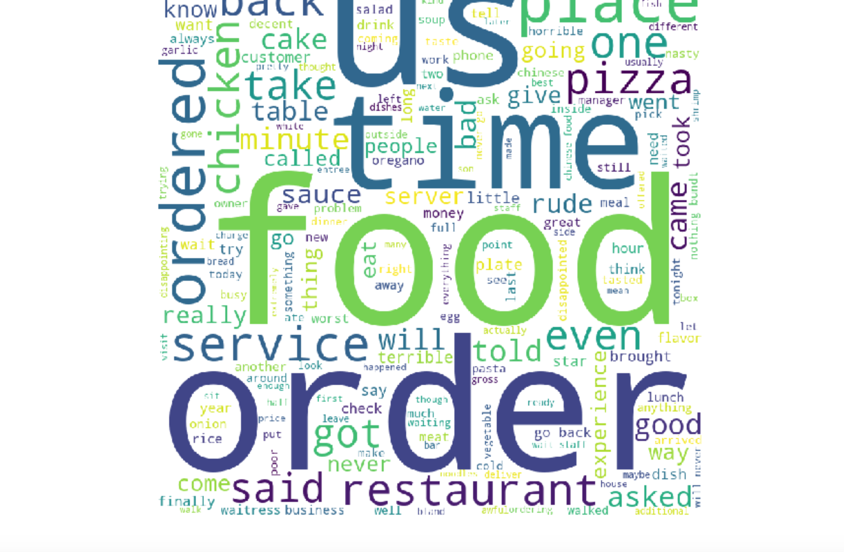
Negative

Slide 31
Evaluation Techniques
Subjectivity
Confusion matrix
We took a subset of reviews (we might need to increase our data size due to the words we have found) (Ex: As words that have had a low sentiment end up in the positive, negative, and neutral word cloud).

Slide 32
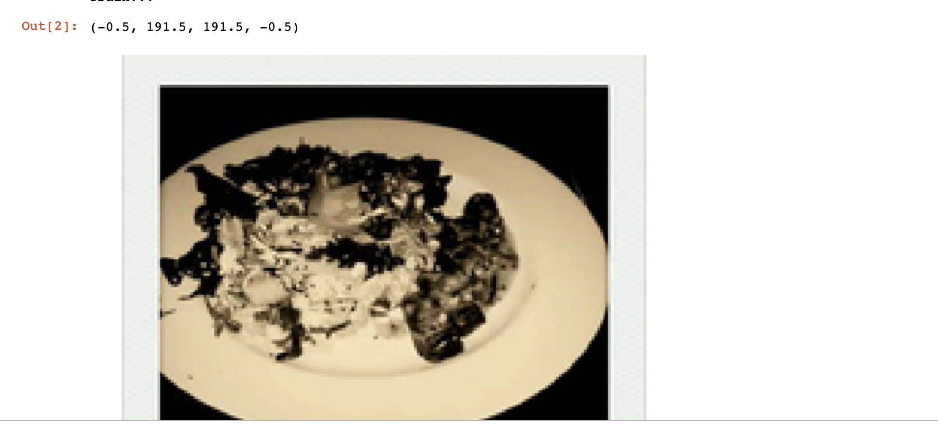
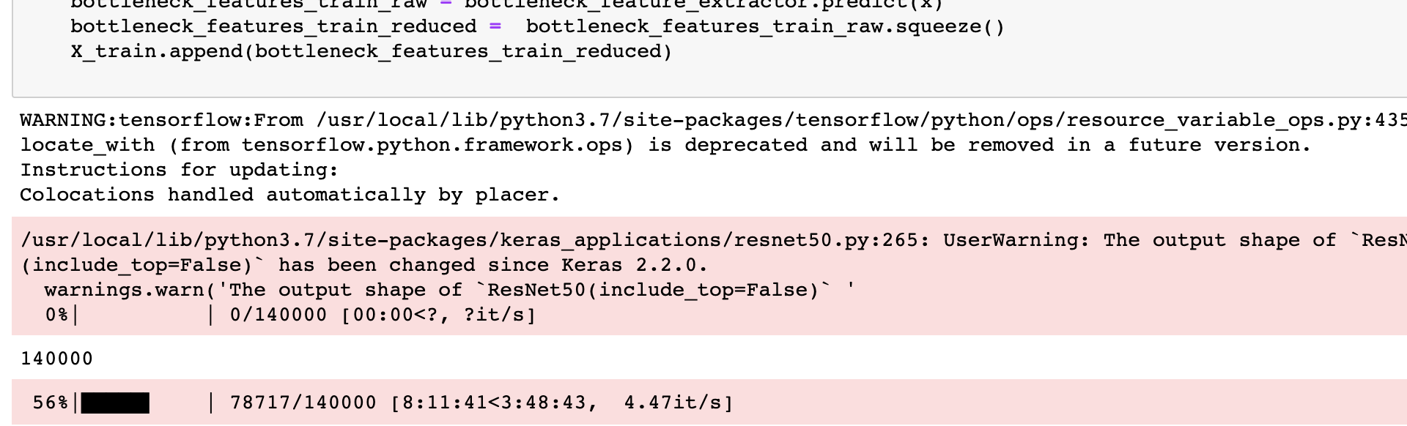
Task # 3 Status on Photos:
Can we create a classifier to determine what label is most representative of a business
['inside' 'food' 'outside' 'drink' 'menu']

Slide 33
Whats next?
Determining what is the best model?
Hyperparameter tuning
Deploy models
Determine plans for maintenance and future work

